Slide 1
Research Based on
Manifold Regularized
Semi-supervised Learning
Reporter：Ma Xueqi

Slide 2
CONTENT
01
Introduction
02
P-Laplacian Regularization
03
Hypergraph p-Laplacian
Regularization
04
Some other Researches

Slide 3
PART
ONE
Introduction

Slide 4
Introduction
Manifold Regularization
Exploring and exploiting the geometry of the probability distribution
Using the geometry of data manifold as a regularizer
Semi-supervised Learning
Including a small number of labeled and a large amount of unlabeled data

Slide 5
Introduction
Laplacian Regularization
The nullspace of the graph Laplacian along the underlying manifold is a constant function.
The solution beyond the domain of training samples is always a constant function.
Hessian regularization
It has a richer nullspace than Laplacian, and the learned function varying linearly along the underlying manifold.
It extrapolates linearly even when the solution is beyond the training data domain.
p-Laplacian Regularization
It is a nonlinear generalization of the graph Laplacian (p-Laplacian becomes standard Laplacian when p=2) .
It has tighter isoperimetric inequality.

Slide 6
semi-supervised regression by using Laplacian, Hessian,
and p-Laplacian regularization

Slide 7
PART
TWO
P-Laplacian Regularization

Slide 8
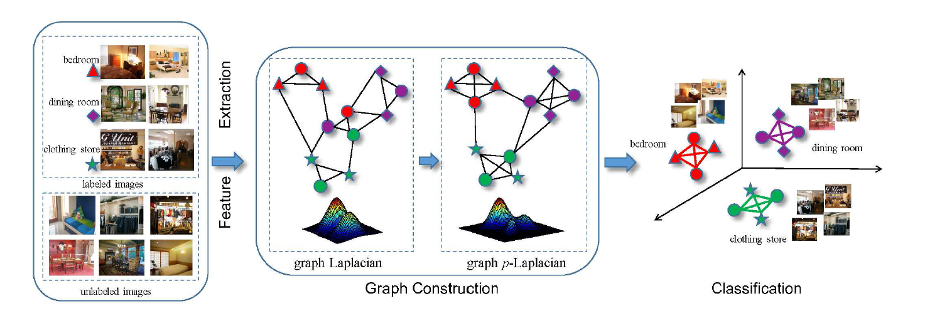
P-Laplacian regularization(pLapR)

Slide 9
PART
THREE
Hypergraph p-Laplacian Regularization

Slide 10
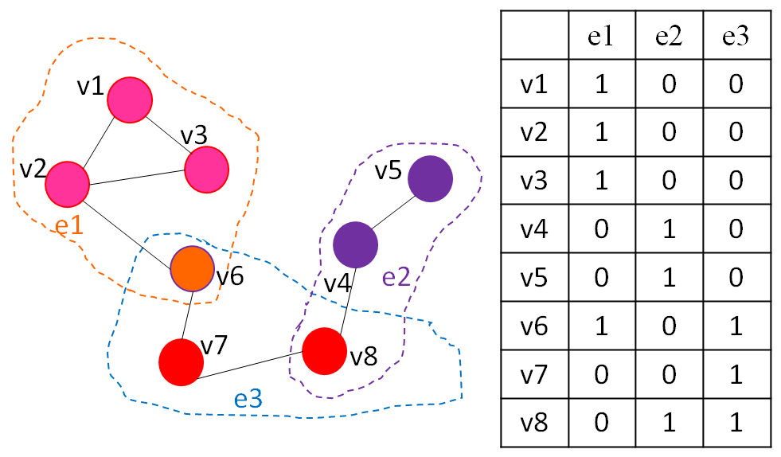
Hypergraph
A simple graph in which two pionts are joined together by an edge if they are highly similarity .
A hypergraph completely illustrates the complex relationship among points by hyperedges .

Slide 11
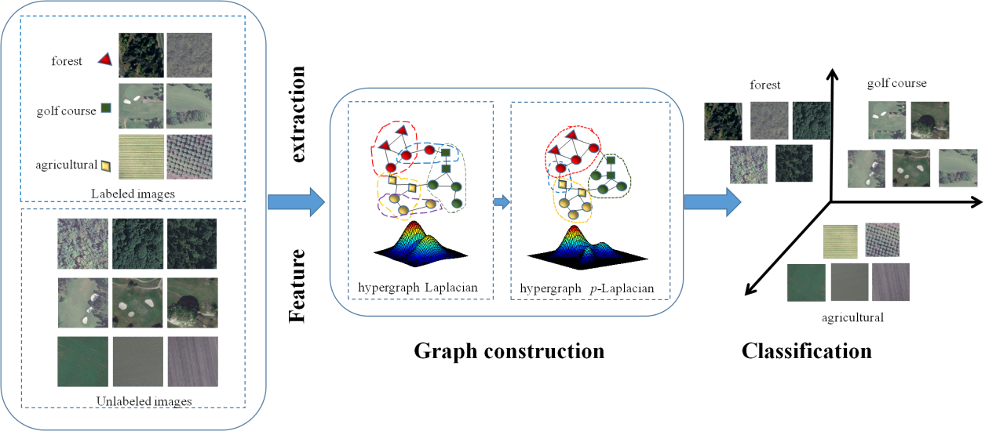
Hypergraph p-Laplacian regularization(HpLapR)

Slide 12
PART
FOUR
Some other Researches

Slide 13
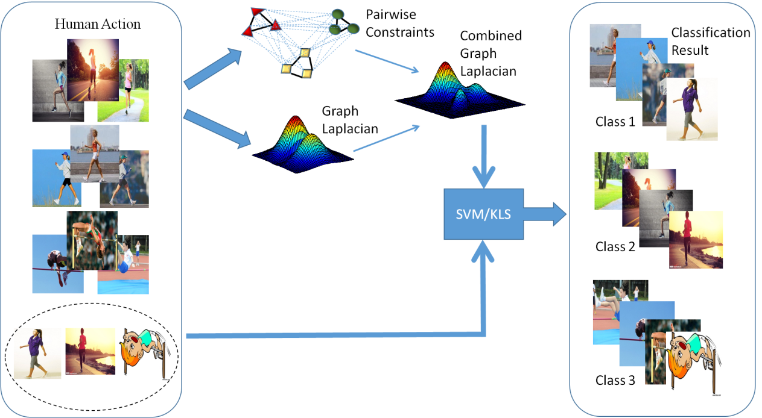
Pairwise constraints
Laplacian regularization

Slide 14
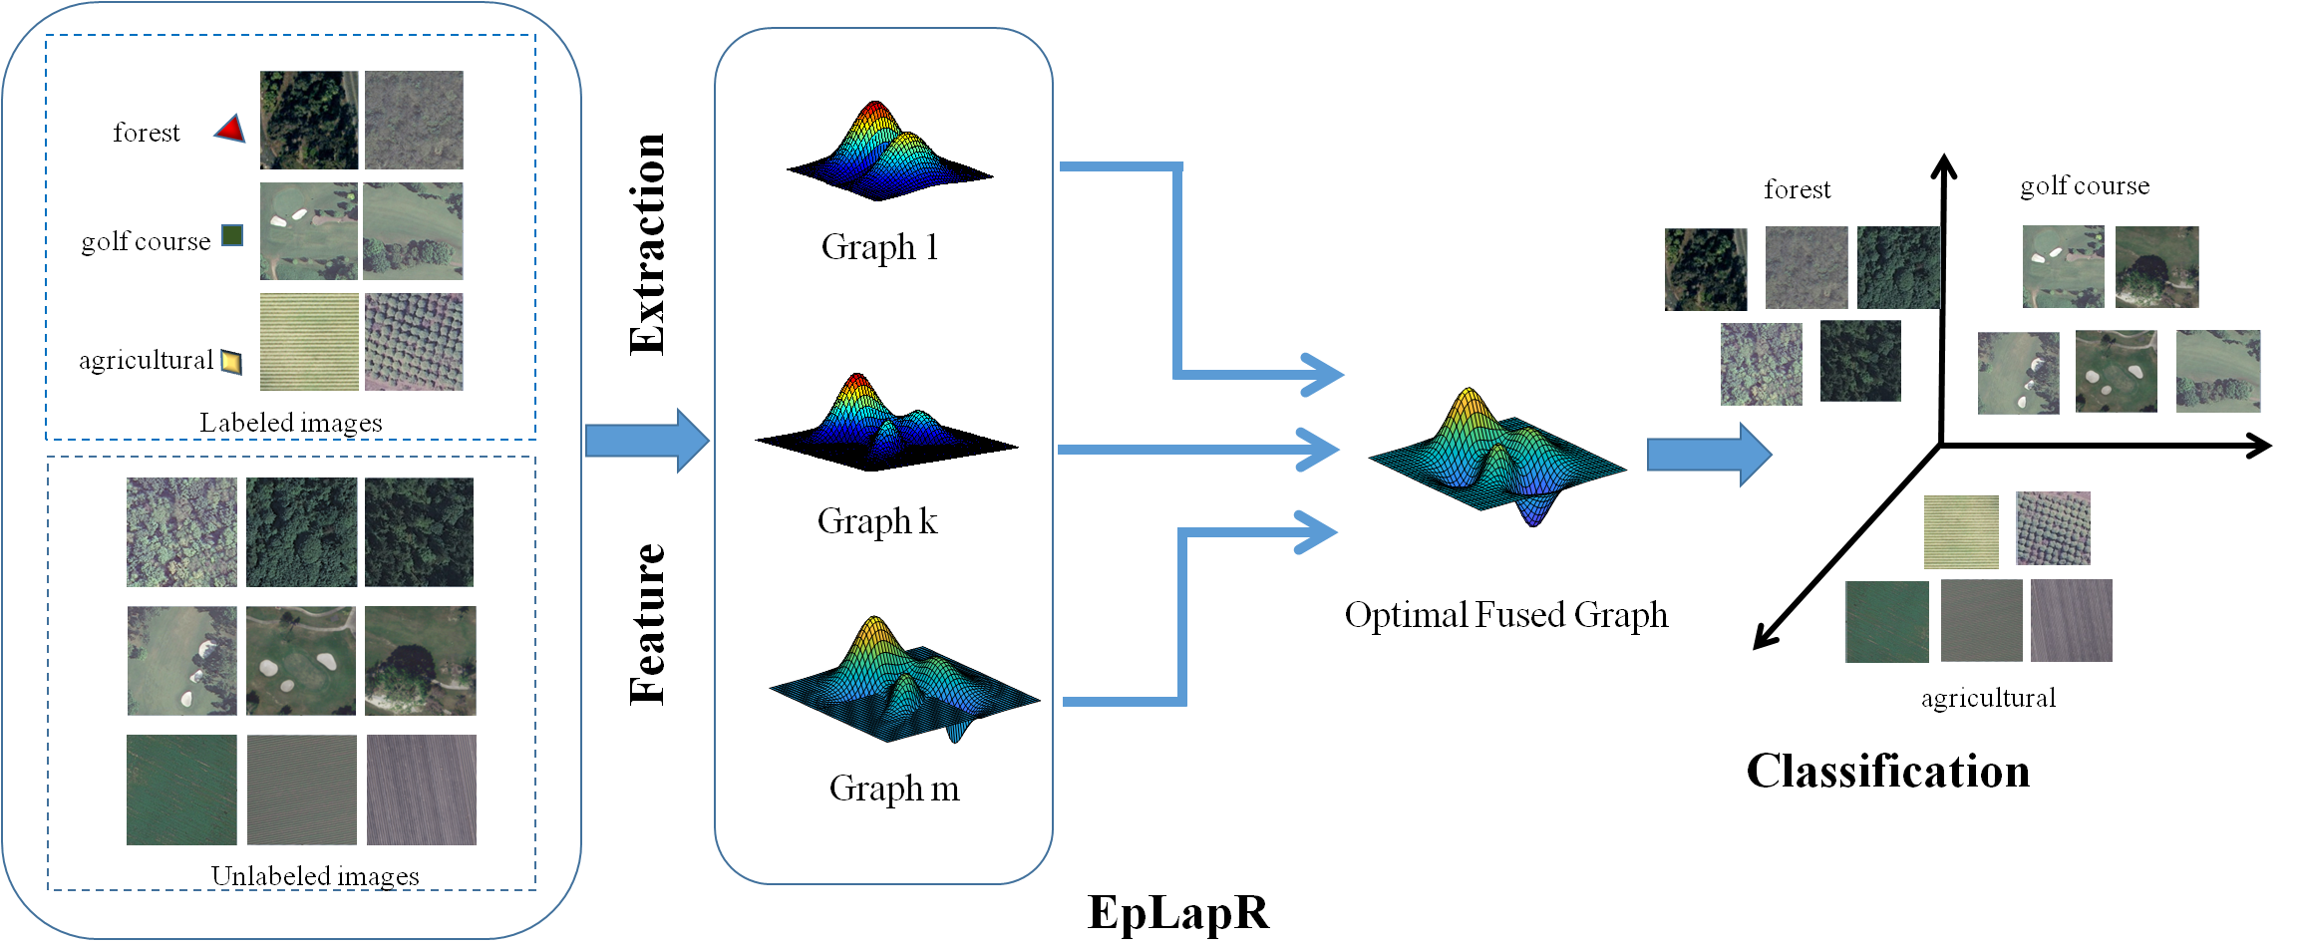
p-Laplacian ensemble regularization(pLapER)

Slide 15
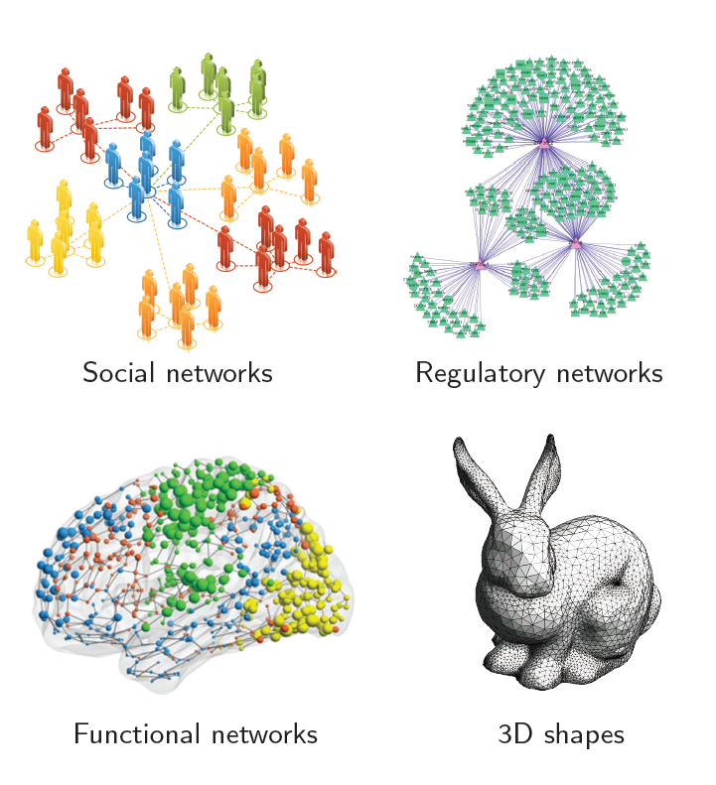
Geometric deep learning on graphs and manifold
Many scientific fields study data with an underlying structure that is a non-Euclidean space (graphs and manifold).

Slide 16
Geometric deep learning on graphs and manifold
voxel-based
Multi-view CNN
point-based CNN (pointNet, pointNet++)

Slide 17
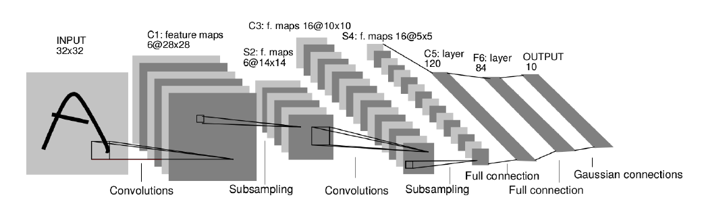
Geometric deep learning on graphs and manifold
Roadmap: extend CNNs to non-Euclidean geometries by replacing filtering and pooling by appropriate operators

Slide 18
Geometric deep learning on graphs and manifold
Extend neural network techniques to graph- or manifold-structured Data
Assumption: Non-Euclidean data are locally stationary and manifest hierarchical structures
How to define compositionality? (convolution and pooling on graphs/manifolds)
How to make them fast? (linear complexity)

Slide 19
Geometric deep learning on graphs and manifold
Graph
Laplacian
Hessian
p-Laplacian
Riemannian manifolds
Riemannian metric describes the local intrinsic structure at x

Slide 20

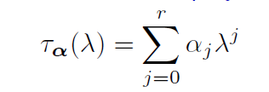
Spectral domain geometric deep learning methods
Spectral graph CNN
Convolution expressed in the spectral domain
Spectral graph CNN with polynomial filters (ChebNet)
Represent spectral transfer function as a polynomial or order r

Slide 21
Spectral domain geometric deep learning methods-Limitation
Poor generalization across non-isometric domains unless kernels are localized (can be remedied to some extent with spectral transformer networks)
Spectral kernels are isotropic due to rotation invariance of the
Laplacian
Only undirected graphs, as symmetry of the Laplacian matrix is
assumed

Slide 22
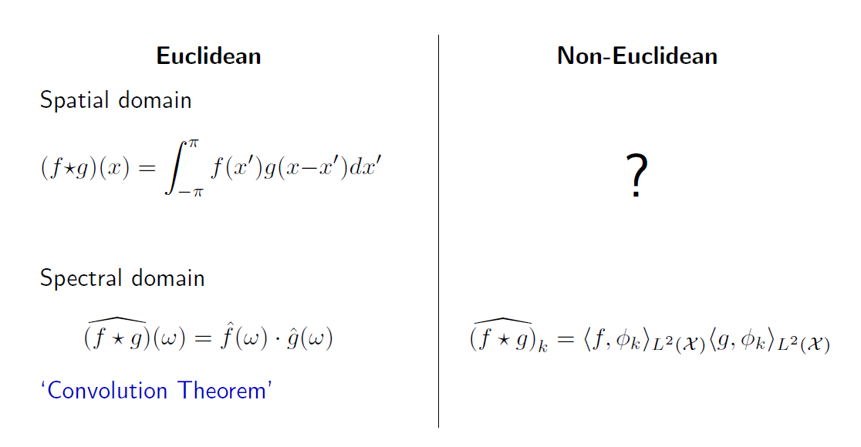
Spatial domain (charting-based) geometric deep learning methods

Slide 23
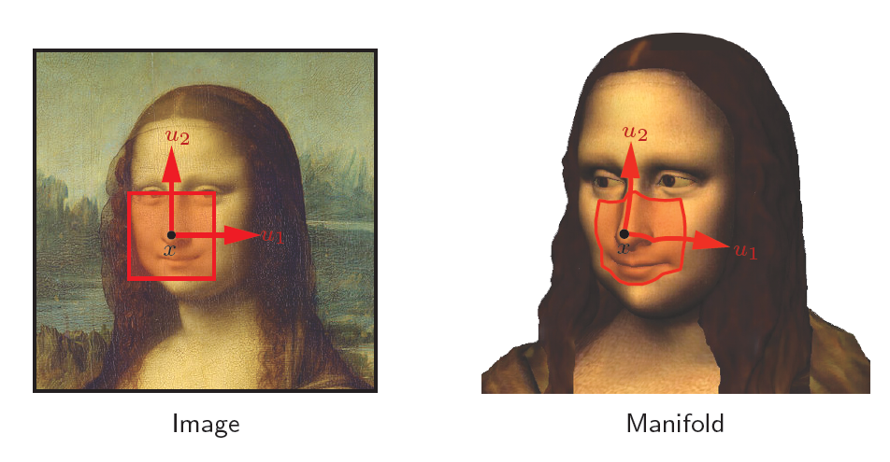
Patch operators

Slide 24
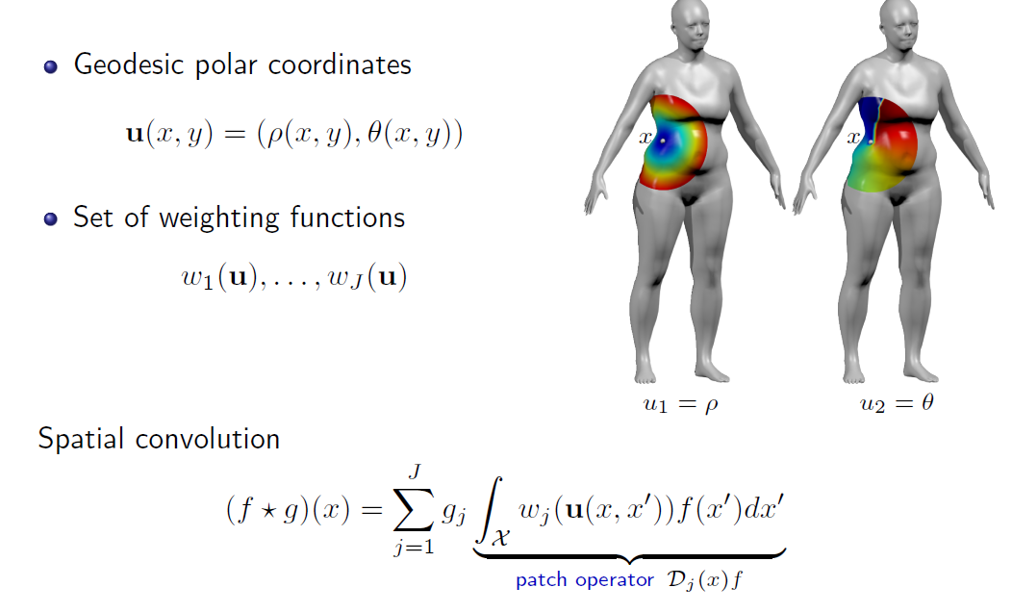
Patch operators

Slide 25
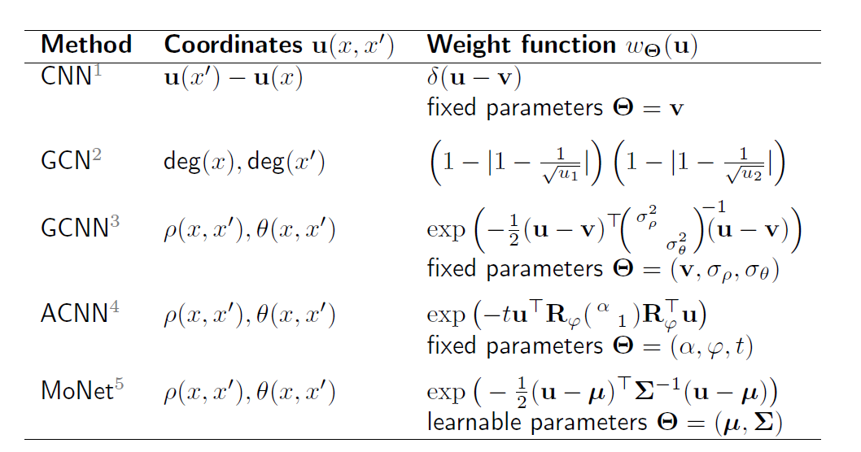
Methods

Slide 26

Thanks for Your Time

